Slide 1
Hi Presenter! Read Me Before Using!
This webinar resource is almost ready for you to use! Be sure to:
Look through and add custom information
Slide 2- Title slide (date)
Slide 3- Presenter information
Slide 5- Housekeeping items
Slide 14-15 Demo Site QR Code Screen Shots (optional)
Slide 16 - 17 – District Specific Examples (optional)
Slide 22 – 23 – Edit to reflect audience (optional)
Slide 27 - Resources (optional)
Slide 28 - Thank you slide
There are presenter notes to help guide you- feel free to edit these
This resource can be customized. Here are some examples of how you can personalize this slide deck to suit the needs of your educators and staff:
Replace our images with screen shots from your environment
Read through slides and ensure terms and jargon will resonate with your board policies/ tool names in your Brightspace environment (i.e. Assignments vs Dropbox, Announcements vs News)
Add additional information to slides specific to your district, including how this helps meet district goals, improvements plans, strategic plans etc
Include your district logo on slides or change the colors used to match your district branding

Slide 2
Engaging with your Students
using Awards and Intelligent Agents
<insert date>
© 2020 D2L Corporation

Slide 3
Presenter Name Title Company/Organization
@Twitter handle

Slide 4
Agenda
Housekeeping
What is Brightspace?
Using the Awards tool to recognize student achievements
Using Intelligent Agents to connect with your students automatically
Resources

Slide 5
Housekeeping Items
How can people ask questions?
Webinar recording and slide deck will be available on ___________
Information about attendance
Notes:
This slide is for you to add Housekeeping Items particular to your District and this session.
It may include information about how attendees can ask questions, how they can access the webinar information after the session, or even how they confirm their attendance for the session (if applicable)

Slide 6
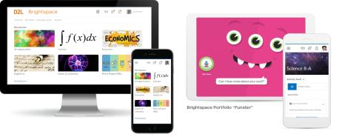
Understanding some terms...
Company:
D2L
Product:
Brightspace
Online Community:
Brightspace Community
Notes:
This is a useful slide to ensure everyone understand the terminology used when discussing Brightspace.
It would be helpful to personalize this slide to include any District specific information, especially if your District as a different branding for “Brightspace.” This will help attendees when they see resources about “Brightspace” to know that this is what your District is using as well but has branded differently.

Slide 7
One platform to collect your teaching resources
Equity for all students
Meaningful connections with students and parents
Why Educators
Brightspace
Tools teachers love
Worry-free technology
Content aligned with curriculum outcomes
Notes:
Here are some reasons Educators love using Brightspace to support their teaching
Tip: Change this up to meet the needs, values and reasons your District loves Brightspace!

Slide 8
Engaging with Students Instructional Demo
Learning Objectives:
Using the Awards tool, you will be able to:
❑ Create a badge (or certificate) with a name, description, availability, expiry, award image and issuer information
Using Intelligent Agents, you will be able to:
❑ Create, set the criteria, schedule, and activate an intelligent agent

Slide 9
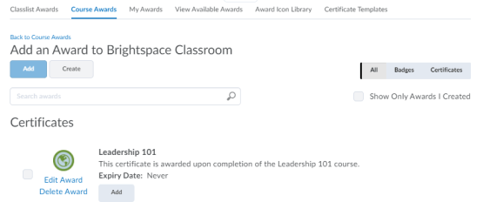
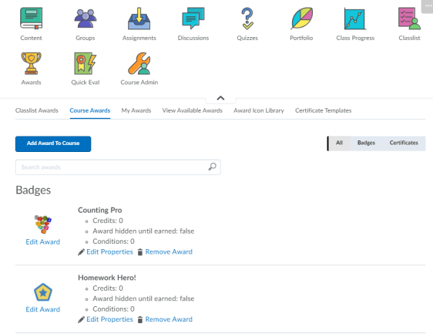
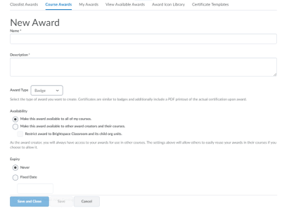
How to Create a New Award
4.
1.
2.
3.
5.
Click Awards
Click Course Awards
Click Add Award to Course
Click Create
Fill in the fields to create your own award
Note: The same workflow applies to the creation of badges and certificates

Slide 10
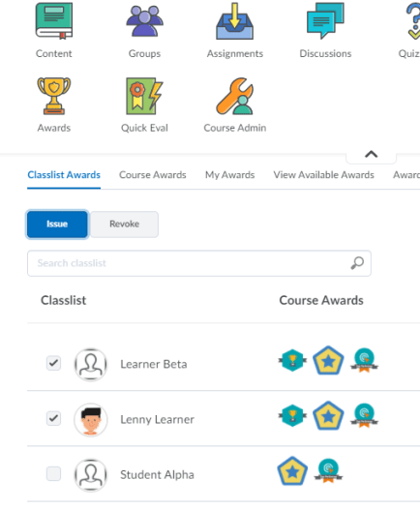
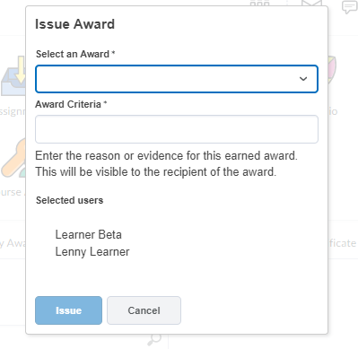
How to Issue an Award
4.
1.
3.
Click Awards
Select the students to receive the award
Click Issue
Select the badge/certificate you want to issue and add the criteria for the recipient
Note: To revoke an award, follow the same workflow
2.

Slide 11
Intelligent Agents monitor course activity based on the criteria you set. Based on the selected criteria (course activity and/ or release condition), you can send emails to your students to promote improved engagement.
Intelligent Agents incorporate the same release conditions criteria found throughout Brightspace. They also have two unique sets of conditions not found in release conditions.
Login Activity: The agent will activate if users haven’t logged into the system for a prescribed period of time. NOTE: Agents can also be used to positively reinforce when students have logged in consistently.
Course Activity: The agent will activate if users haven’t accessed a course for a prescribed period of time.
NOTE: Agents can also be used to positively reinforce when students accessed their course consistency
What is an Intelligent Agent?

Slide 12
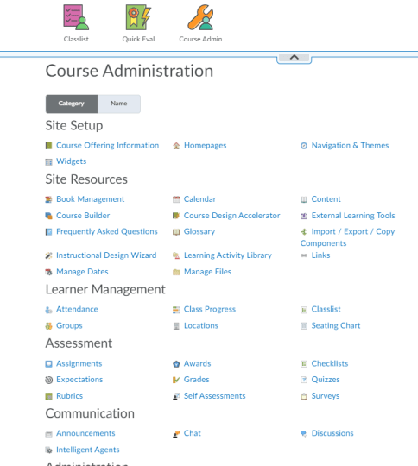
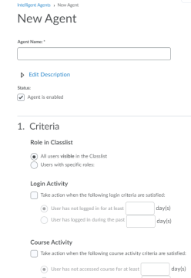
How do I create an Intelligent Agent?
1.
3.
4.
1. Click Course Admin from your NavBar
2. Click on Intelligent Agents
3. Click on New
4. Fill in the fields to create a new Intelligent Agent
Make sure your Agent is set to “Enabled”
2.

Slide 13
Learning Objectives
Give it a try!
Engaging with Students
Learning Objectives
Today you learned how to:
Use the Awards tool to:
❑ Create a badge (or certificate) with a name, description, availability, expiry, award image and issuer information
Use Intelligent Agents to:
❑ Create, set the criteria, schedule, and activate an intelligent agent

Slide 14
Take Away Activity
Awards:
Create a welcome badge using a provided image and personalize it to be issued by you.
Intelligent Agents:
Create an intelligent agent by enabling the agent, setting the criteria, updating its schedule, and filling out a message.
Give it a try!

Slide 15
Resources
Brightspace Quick Start Guide K-12
D2L Parent and Guardian Support Site
D2L One Minute Workflow Videos
D2L Educator Webinar Archive
Notes:
This page has resources specifically on how to Get Started with Brightspace. This is also where District specific resources can be added.

Slide 16
Tutorial Videos
Communication and Collaboration | Organizing Course Materials | Documenting Student Learning | Feedback & Assessment
Announcements Activity Feed -Add Attachments and Links to Posts -Create an Assignment Post in Activity Feed -Customize Notifications for Activity Feed -For posting a message -Optimize Activity Feed Discussions | Content/Lessons Tool -Getting Started with Lessons for Instructors -Lessons: Add a New Unit and Lesson -Lessons: Add New Materials -Lessons: Reorder Units, Lessons, Folders, and Materials -Lessons: Attach a Release Condition Groups -Creating Groups -Creating Individual Student Groups -Creating Unique Learner Pathways | Brightspace Portfolio -Review and Approve Portfolio Items -Oversee and View Individual Portfolios -Brightspace Portfolio: Bring Your Own Device (for learners) -Portfolio AT HOME Assignments Discussions Quizzes -Quiz Question Converter | Rubrics -Create an Analytic Rubric -Create a Holistic Rubric Grades -Entering Grades -Associate an Activity with a Grade Item -Create a Grade Scheme Standards/Expectations -Standards: Import Standards from Course Admin Assessing or Evaluating Against Expectations Quick Eval
Notes:
There are also many quick tutorial videos available! These resources are organized pedagogically. Every underlined item is linked to a tutorial video

Slide 17
Thank you!
@Twitterhandle
#districthashtag
#D2LK12
Notes:
Thank you so much for joining us today!
If you have any questions or need any help, please consult or contact:
We’d love to see all the awesome ways you’re using Brightspace! Use our District hashtag and/or #D2LK12 so we can all learn from each other and share great ideas of how to use Brightspace to support teaching, learning and, most importantly, our students!

